Slide 1
IOT Based Garage Door Opener
Presented By : Manpreet Kaur c0757604 (Group 4)

Slide 2
Interfacing of IR Sensor with Beaglebone Black
(To detect an obstacle)

Slide 3
Content:
Importance of interfacing
Hardware Requirements
Software requirements
Beaglebone Black : Features, Compatibility, connectivity
Proximity IR sensor : Advantages, applications
Hardware Interfacing
Software Coding
Code Explanation
Troubleshooting
Conclusion
References

Slide 4
Importance of this interfacing in our project
In embedded systems various aspects are analyzed and determine for the overall success of the project. One of the most important part of any project is the security of the user whether its physical security or security of their crucial information. Therefore, the design of the project must be finalized by keeping the security of the user a priority. Hence in our project we are using the IR sensor to detect any obstacle while the garage door is being closed to prevent any potential damage.

Slide 5
Hardware Requirements:
Beaglebone Black
Proximity IR sensor
Jumper wires and Breadboard
L298N Motor driver
Dc motor
USB Cables
Host machine (Laptop)

Slide 6
Software Requirements:
Linux based OS (Debian)
GNU Compiler
Nano Editor
Libraries(required for the component interfacing)

Slide 7
Beaglebone Black : Features
BeagleBone Black is a low-cost, community-supported development platform for developers.
It consists of two header P8 and P9 having numbers of input and output pin.
It also use different communication protocols to communicate with components like I2C, UART, GPIO etc.
It has AM335x 1GHz ARM Cortex-A8 processor with 512MB DDR3 RAM.
It also have 4GB 8-bit eMMC on board flash memory.

Slide 8
Beaglebone Black : Software Compatibility
Debian
Android
Ubuntu
Cloud Ide on Node.js w/ BoneScript library etc.

Slide 9
Beaglebone Black : Connectivity
Ethernet
HDMI
USB Client for Power and Communications
USb Host
2*46 Header Pins

Slide 10
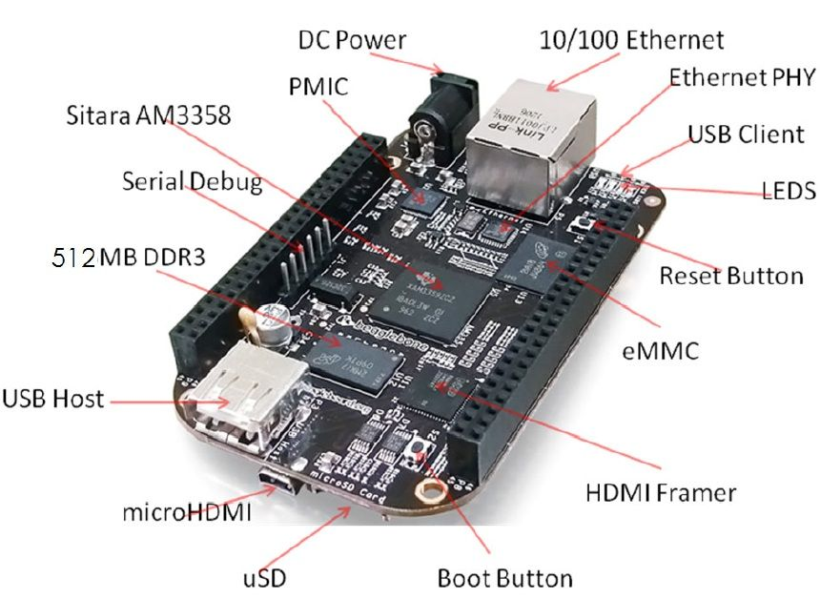
Beaglebone Black

Slide 11
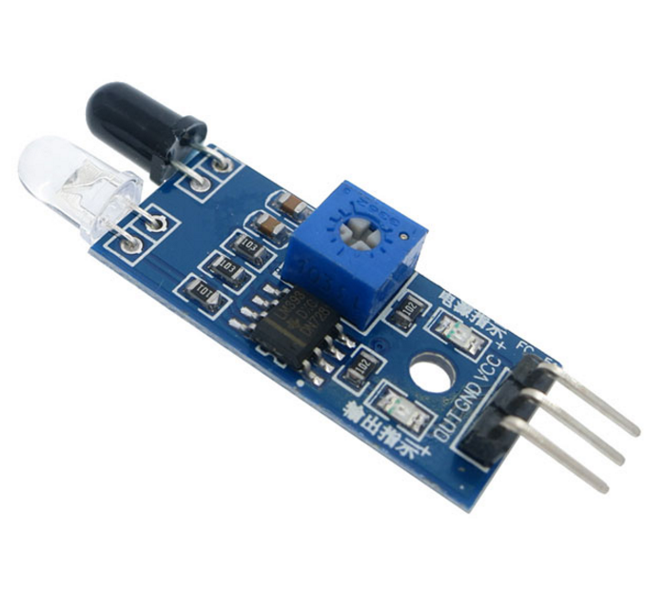
Proximity IR Sensor
IR(Infrared )Proximity sensor detects the presence of an object by by emitting a beam of infrared light.
It Consists of an IR led, which emits the light and Reflected light will be detected by a photodiode.

Slide 12
Proximity IR Sensor
It has on board potentiometer to adjust the range of detection.

Slide 13
Proximity IR Sensor : Advantages
Contactless Detection
Applicable for daytime and Nighttime uses.
Able to measure the distance of soft surfaces
Accuracy of IR sensors are not affected by Corrosion or oxidation.

Slide 14
Proximity IR Sensor : Common Applications
Distance Measurement
Can be used as a counter
Monitoring and control appliances

Slide 15
Hardware interfacing: Beaglebone black and IR sensor
Pin 17 of header 8 is connected to Motor IN1 terminal
Pin 18 of Header 8 is connected to Motor IN2 terminal
Pin 7 of header 8 is connected to IR Sensor
Ground of bbb to ground of IR sensor
5v of bbb to positive terminal of IR sensor

Slide 16
Software Coding: Overview
Coding in Beaglebone black can be done in C/C++ and Python. For our project we are mostly using C/C++ programming language.
Before writing a code in nano editor, there can be some specific libraries and header files required to download to execute the program successfully.
For this we have successfully download header file iobb.h

Slide 17
Software Coding: Downloading Libraries
Login into Beaglebone black ssh debian @192.168.7.2
Checking the internet connection using Ping google.com
Make a directory named libr using mkdir directory name
Clone iobb.h libraries from git using git clone “copying the repository link”
Make and install the libraries in Beaglebone Black

Slide 18
Software Coding: Writing code in nano editor
Connecting the beaglebone black using ssh debian@192.168.7.2 and enter default password temppwd.
Open the nano terminal using pir_s.c
Write the code for the interfacing ; use ctrl + o to save and ctrl + X to exit.

Slide 19
Software Coding: Code explanation
Step 1: Including libraries
#include <stdio.h> // includes standard I/O header files
#include <iobb.h> //includes GPIO I/O header files
#include <unistd.h> //includes POSIX API library for adding delay in operation

Slide 20
Software Coding: Code explanation
Step 2: defining pins
#define Right 8,17 //pin 17 of header 8 (IN1) - connected to DC Motor terminal
#define Left 8,18 //pin 18 of header 8 (IN2) - Connected to Dc Motor terminal
#define IRbtwnDoor 8,7 //pin 7 of header 8- defining the digital Input pin of IR sensor

Slide 21
Software Coding: Code explanation
Step 3: start of main function and setting gpio pins
int main(void) // main function
{
iolib_init(); // initializing GPIO I/O library
iolib_setdir(IRbtwnDoor, DigitalIn); //setting GPIO pin of IR sensor for input
iolib_setdir(Right, DigitalOut); //setting GPIO pin of IN1 of relay module as output
iolib_setdir(Left, DigitalOut); //setting GPIO pin of IN2 of relay module as output

Slide 22
Software Coding: Code explanation
Step 4: Logic for operation
while(1) //continuous loop- means it will repeatedly execute the target statement until the condition is true
{
if (is_high(IRbtwnDoor)) //if pin 8 of header is low
{
printf("Motor Start \n"); //print on terminal
pin_high(Right); //in1 pin of relay motor is high
pin_low(Left); //in2 pin of relay motor is low
usleep(1200000); //delay operation
}
if (is_low(IRbtwnDoor)) // if pin 8 of header is high
{
printf("Motor Stop \n"); //print on terminal
pin_low(Right); //in1 pin of relay motor is low
pin_low(Left); //in2 pin of relay motor is low
usleep(1200000); //delay operation

Slide 23
Software Coding: Code explanation
Step 4: End of program
}
}
}
}
iolib_free(); //end of program (freed library resources)
return(0); //return a value
}

Slide 24
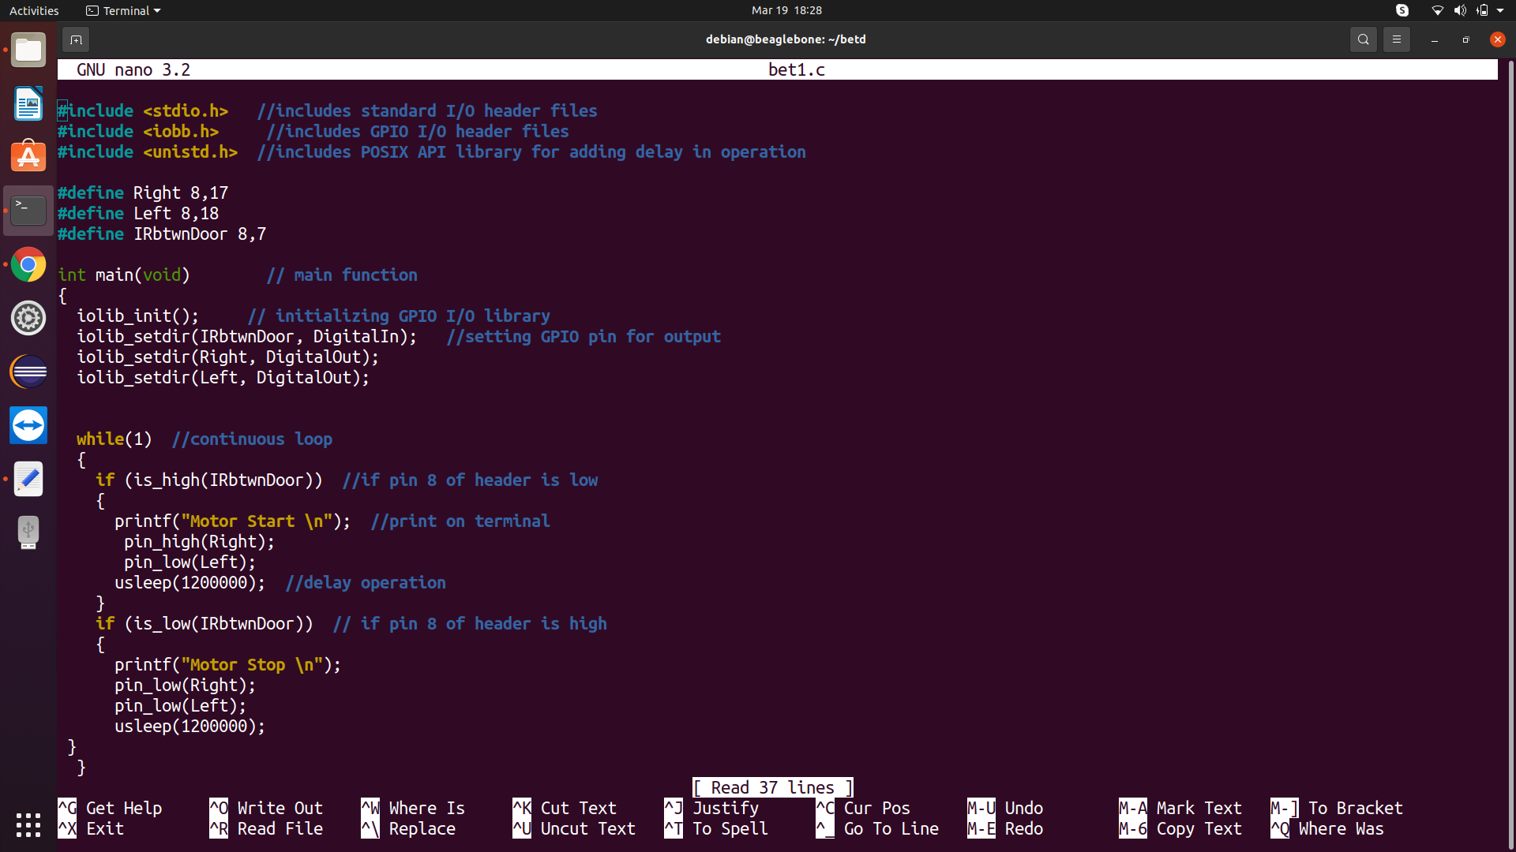
Software Coding: ScreenShot

Slide 25
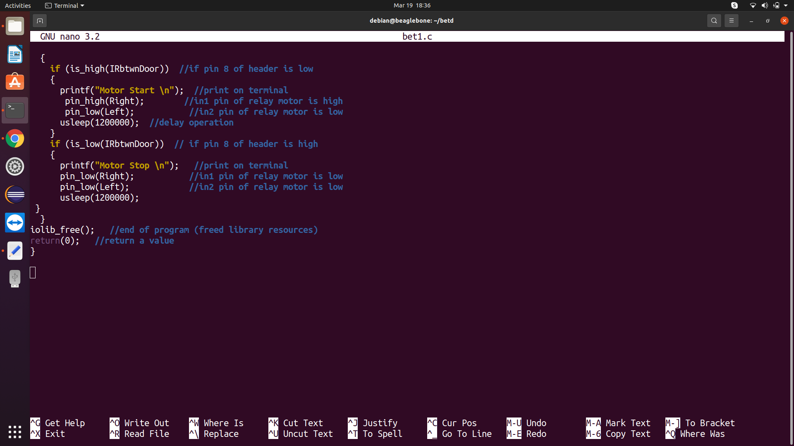
Software Coding: ScreenShot

Slide 26
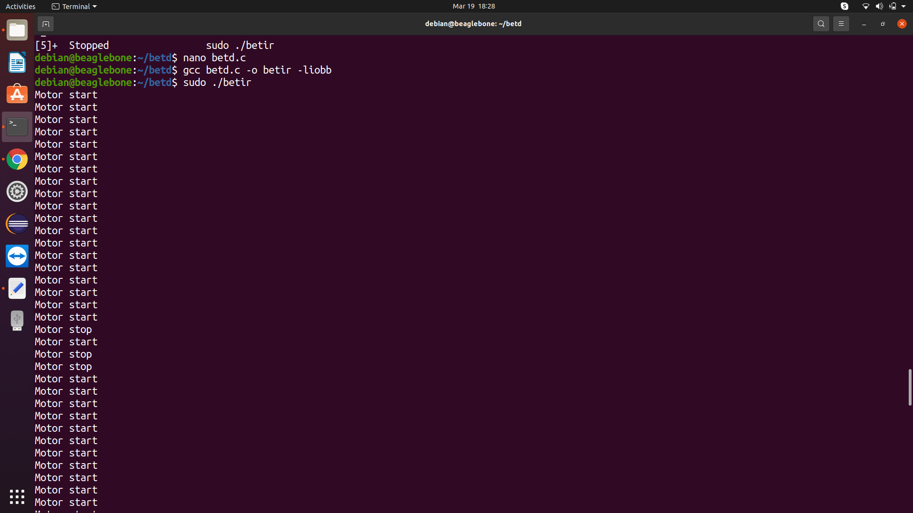
Software Coding: Output

Slide 27
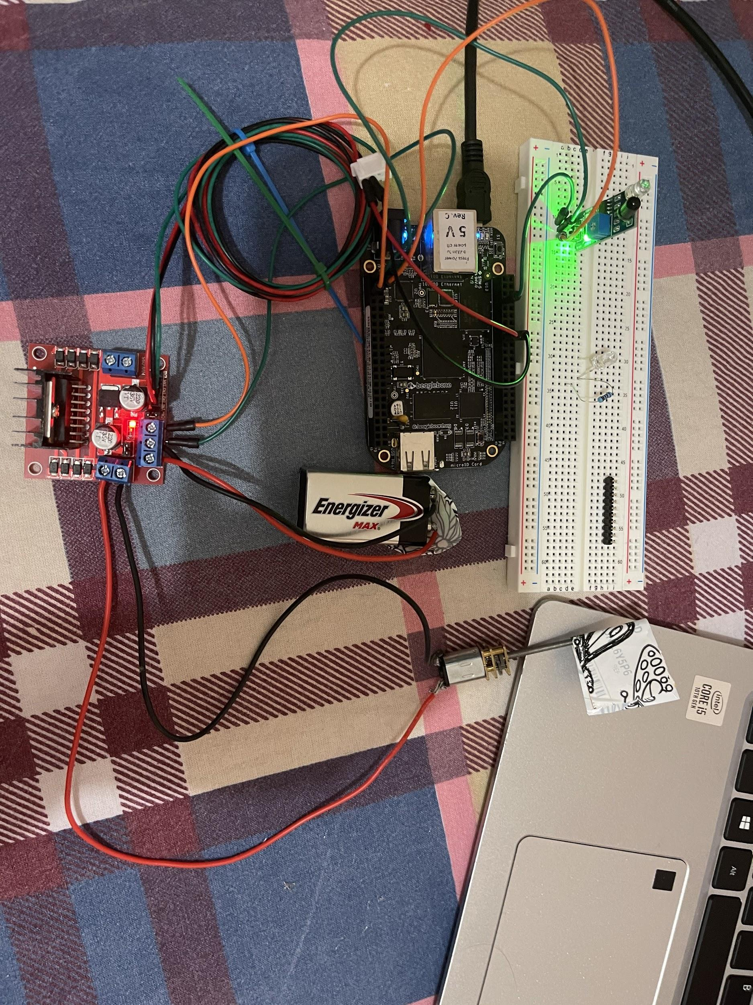
Hardware : Picture

Slide 28
Troubleshooting
When I run my code on bbb the DC motor did not start. Because the connections were loose. I made the connections again and then it ran successfully
While writing the code It was difficult for me to understand the logic of IR sensor. Hence when I initially wrote the code the logic was opposite. But eventually it turned out as it was meant to be.

Slide 29
Conclusion
By making the above connections I was successfully able to run the code on my hardware.
The desired output was achieved by the above procedure from all the hardware and software components.

Slide 30
References
Retrieved from seeedstudio. 2019, all about proximity sensors
URL: https://www.seeedstudio.com/blog/2019/12/19/all-about-proximity-sensors-which-type-to-use/
Retrieved from Beagleboard.org
URL:https://beagleboard.org/black
Retrieved from Open group.org
URL:https://pubs.opengroup.org/onlinepubs/000095399/functions/usleep.html

Slide 31
References
Shabaz Github (2019, August 17). Retrieved from https://github.com/shabaz123/iobb
Shabaz (2019,August 14) Element14.com Retrieved from https://www.element14.com/community/community/designcenter/single-board-computers/next-genbeaglebone/blog/2019/08/15/beaglebone-black-bbb-io-gpio-spi-and-i2c-library-for-c-2019-edition
Usleep Linux manual page (2017,September 15) Retrieved from https://man7.org/linux/man-pages/man3/usleep.3.html

